Slide 1
DNA
Standard: Students will recognize how biological traits are passed on to successive generations.

Slide 2
What is DNA?
Deoxyribonucleic acid
Found in both prokaryotic and eukaryotic cells.
Code that contains information for an organism’s growth and function
Found inside the nucleus on chromosomes for eukaryotic cells

Slide 3
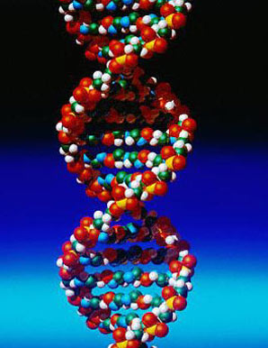
DNA is shaped like a…
Twisted ladder
This shape is known as a double helix

Slide 4
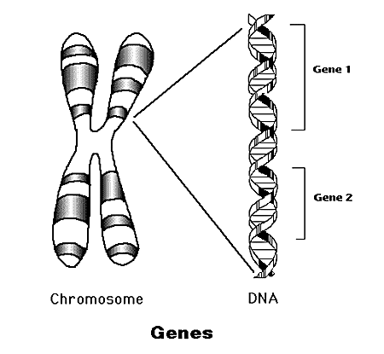
What are genes?
Section of DNA on a chromosome that contains instructions for making specific proteins.
These specific proteins are what create the specific traits for individuals. For example eye color, hair color, etc.

Slide 5
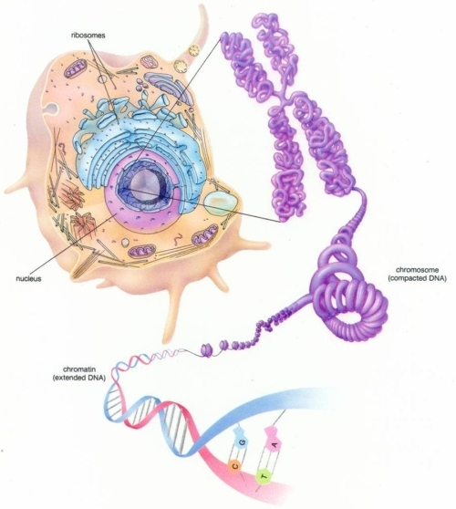
Level of organization (Largest to smallest)
Eukaryotic cell → nucleus → chromosome → DNA → genes

Slide 6
How do you obtain your genes?
Through heredity

Slide 7
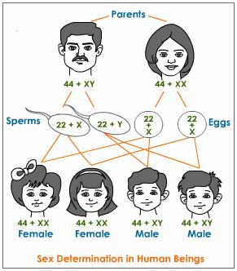
What is heredity?
The passing of traits (genes) from parent to offspring.

Slide 8
Heredity occurs by…
Either Asexual or sexual reproduction
Asexual = Offspring has identical traits as parent (one parent)
Sexual = Offspring has different traits as parents (two parents)

