Slide 1
Charles Darwin & The Start of the Theory of Evolution
Standard: S7L5a. Explain that physical characteristics of organisms have changed over successive generations.

Slide 2
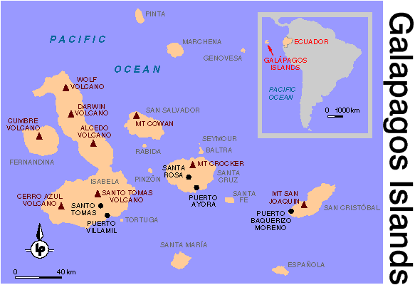
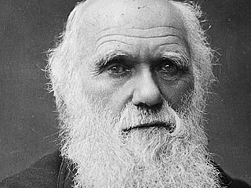
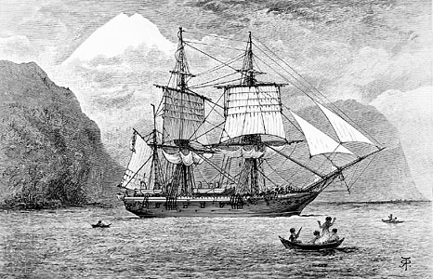
Who is Charles Darwin?
Sailed from England on HMS Beagle to the Galapagos Islands in 1831.
The Galapagos Islands originally came from Central and South America.

Slide 3
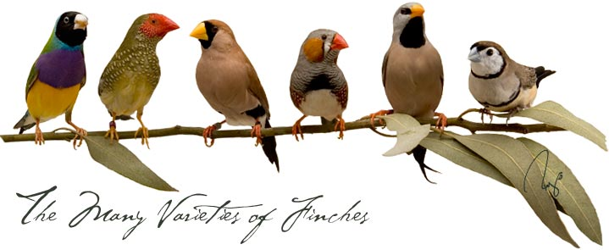
What did he do?
He observed 13 species of finches on the islands.
Observe 13 species of finches on the islands.
He noticed all 13 species were similar to each other and to species of finches on the mainland.
Except for differences in body size, beak shape, and eating habits.
Observations lead him to reason that the finches must have to compete for food, and certain beaks helped survive on different islands

Slide 4
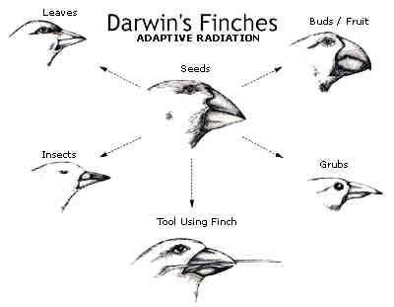

Slide 5
How did Darwin’s observations lead him to hypothesize that physical characteristics of species have changed over time?
Darwin observed that on islands with different environmental conditions you had finches that were similar but all had unique differences (variations).
He used his observations to infer that the finches must have changed over time from a common ancestor.

Slide 6
What are some conclusions Darwin made from his observations?
1. Competition for limited food resources lead to an increased diversity among species.
2. Evolution occurs through the process of natural selection
Natural selection means that organisms with traits best suited to their environment are more likely to survive and reproduce.
3. Natural selection occurs over so many generations, it is impossible to see changes occur.

Slide 7
What was Darwin’s theory?
Darwin’s theory became known as the theory of evolution by natural selection.
Natural selection means that organisms with traits best suited to their environment are more likely to survive and reproduce.

Slide 8
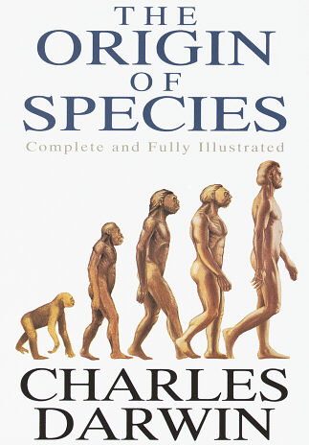
How did Darwin share his research?
He wrote a book titled “On The Origin of Species,” which was published in 1859.
Lead to the start of the modern day Theory of Evolution

